Slide 1
ABOUT US

Slide 2

Our purpose
We are the central agency supporting access to quality, contemporary learning and development for public mental health workforce development
in Victoria (including
consumer and family
carer workers).

Slide 3

Our partners
We work in collaboration with the DHHS and with stakeholders across the sector to build mental health workforce capability, practice supports, knowledge translation and innovation.

Slide 4




team
Rosemary Charleston
Kylie Boucher
Krystyn Smale
Lorna Downes
Director
Senior Project
Lead
Consumer
Workforce Development Coordinator
Family Carer Workforce Development Coordinator

Slide 5

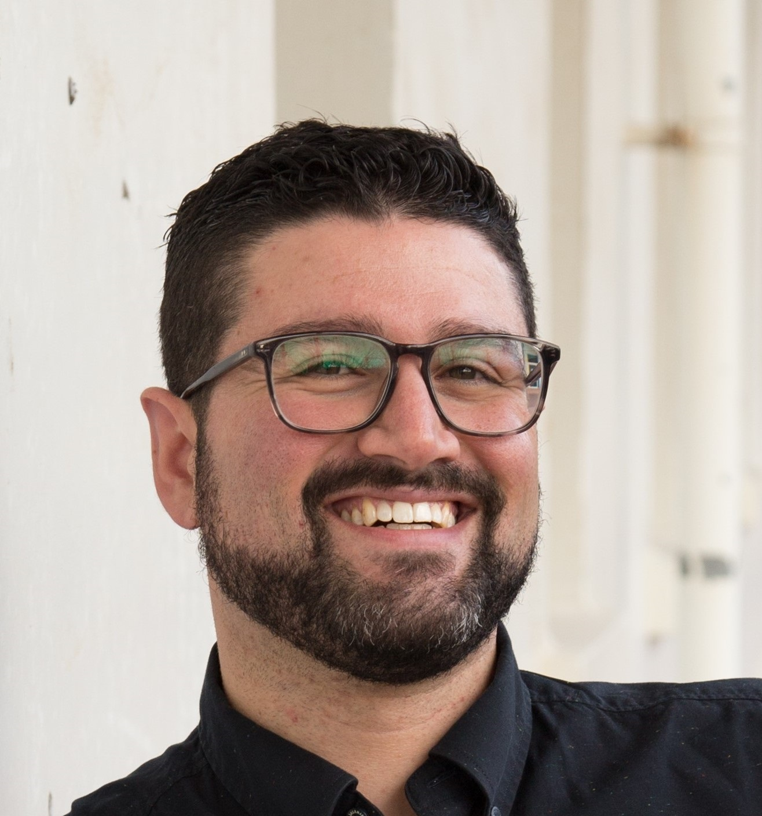

TEAM
Mary Wang Arrigault
John MIzzi
Amanda Pattie
Date, Research and Evaluation Coordinator
Learning & Workforce Development
System Support
Administration

Slide 6
CMHL strategic leadership
Engagement &
communication
Evidence &
quality
Innovation &
systems change
Alignment &
coordination

Slide 7
Consumer & Family Carer Workforce Development
Our vision: The Victorian consumer and family carer lived experience (peer) workforces are valued, resourced and supported in their work.
The Consumer Workforce Development Coordinator and the Family Carer Workforce Development Coordinator are key team members of the CMHL.
They work closely with consumer and family carer workers, the Department of Health and Human Services (DHHS), training organisations, health services, and peak bodies to support the development of the mental health lived consumer and family carer workforces in Victoria.

Slide 8


Identifying the support and development needs of the consumer and family carer workforces and their organisations.
The Consumer Workforce strategy will be launched in March 2019
The Family Carer Workforce strategy will be launched in March 2019
Training and activities to address identified workforce needs.
Scheduled training and events
Self directed or on request training and events

Slide 9
Resources to support
the consumer and carer workforce and their organisations.
Resources
Networks and communities of practice in relation to lived experience work.
See Networks and Communities of Practice
or contact us

Slide 10
Current priorities and work
Workforce Development Strategies
CMHL consumer and family carer leadership and collaboration
Consumer and family carer perspective supervision
Organisation readiness
Consumer-led and family carer-led innovation grants
Networks and communities of practice
Notes:
The Strategies are live action plans with stewardship held by key workforce partners including the CMHL,
The Carer Lived Experience Workforce (CLEW), SHARC, Tandem, VMIAC and DHHS

Slide 11
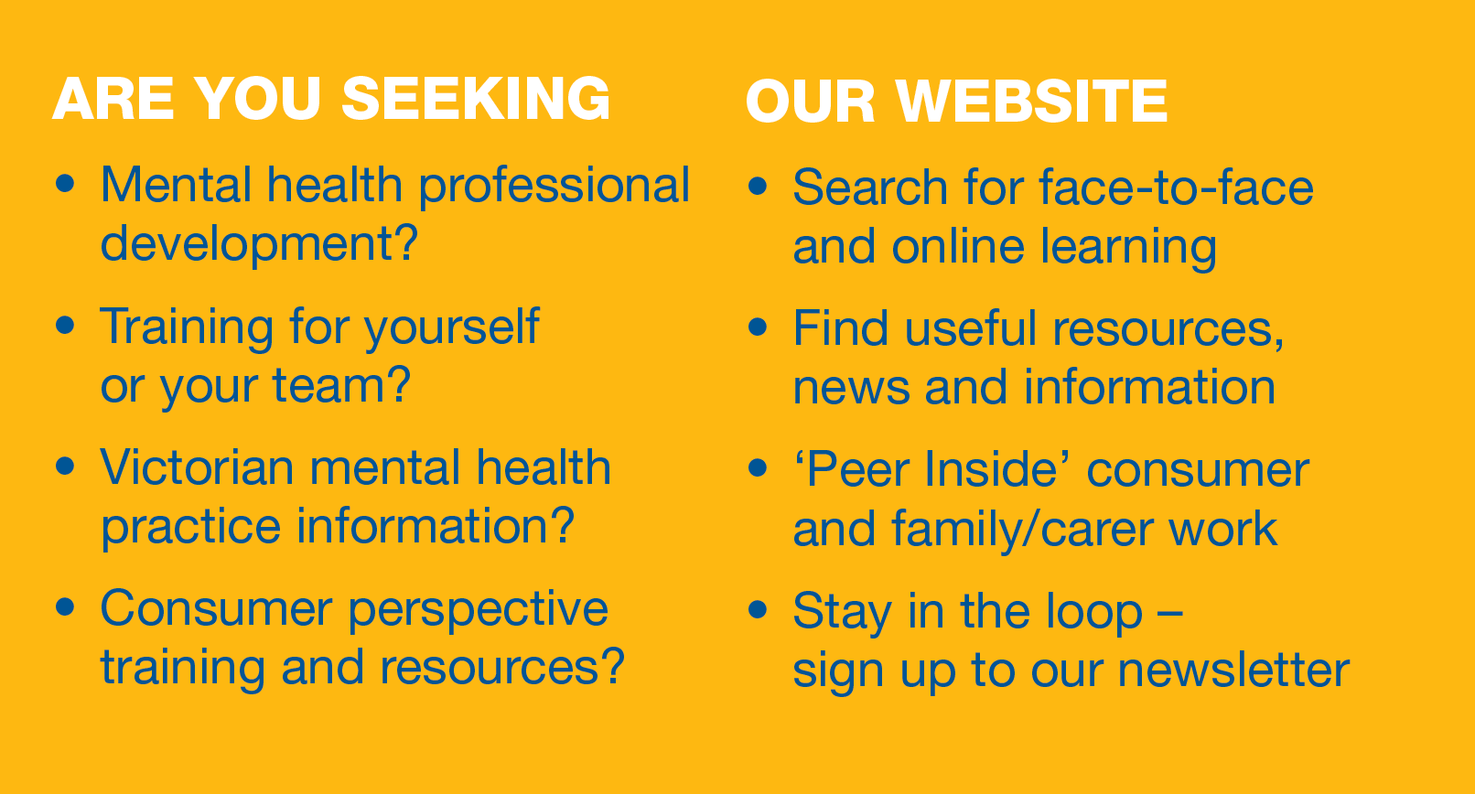
cmhl.org.au

Slide 12


Thank you
contact@cmhl.org.au
cmhl.org.au
@CMHLvic

